Slide 1

A Plankton Classifier Chatbot using SAP’s ConversationalAI and Transfer Learning and Here and Here
NOTE: Delete the yellow stickers when finished.
See the SAP Image Library for other available images.
Speaker’s Name, SAP
Month 00, 2019
You can easily change the classification on all slides with the Presentation Wizard. Go to File → Change Classification
Partner logo

Slide 2
Title Goes Here and Here and Here
Speaker’s Name, SAP
Month 00, 2019
Partner logo

Slide 3
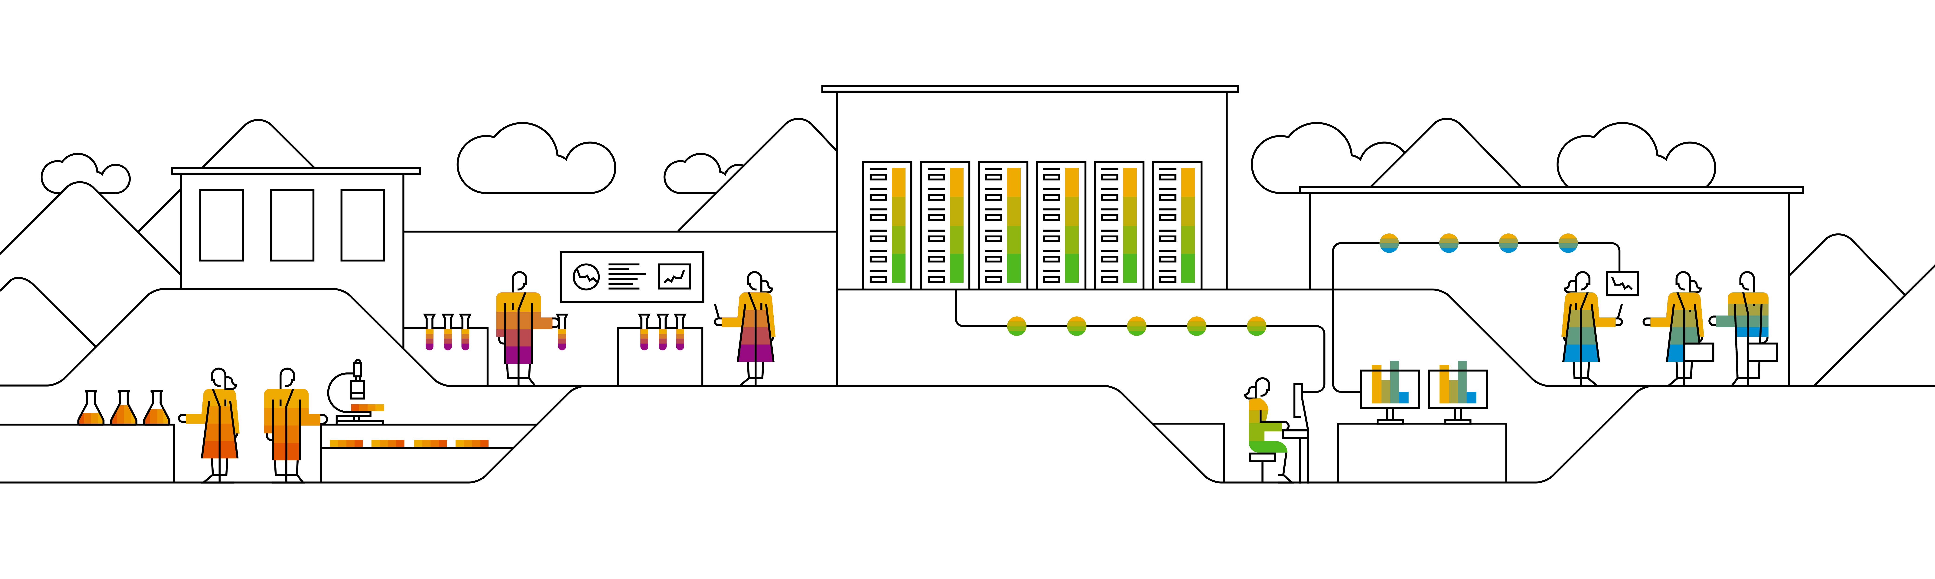
Title Goes Here and Here and Here
Speaker’s Name, SAP
Month 00, 2019
Partner logo

Slide 4

Title Goes Here and Here and Here
Speaker’s Name, SAP
Month 00, 2019
Partner logo

Slide 5
Agenda
Agenda item/divider headline
Details
Agenda item/divider headline
Details
Agenda item/divider headline
Details
Agenda item/divider headline
Details

Slide 6
Divider page

Slide 7
Key Concepts

Slide 8












Key concepts #1 What’s a bot?
A bot is a program that automatize a task. Through messaging channels clients make a request. The bot understands and executes.

Slide 9
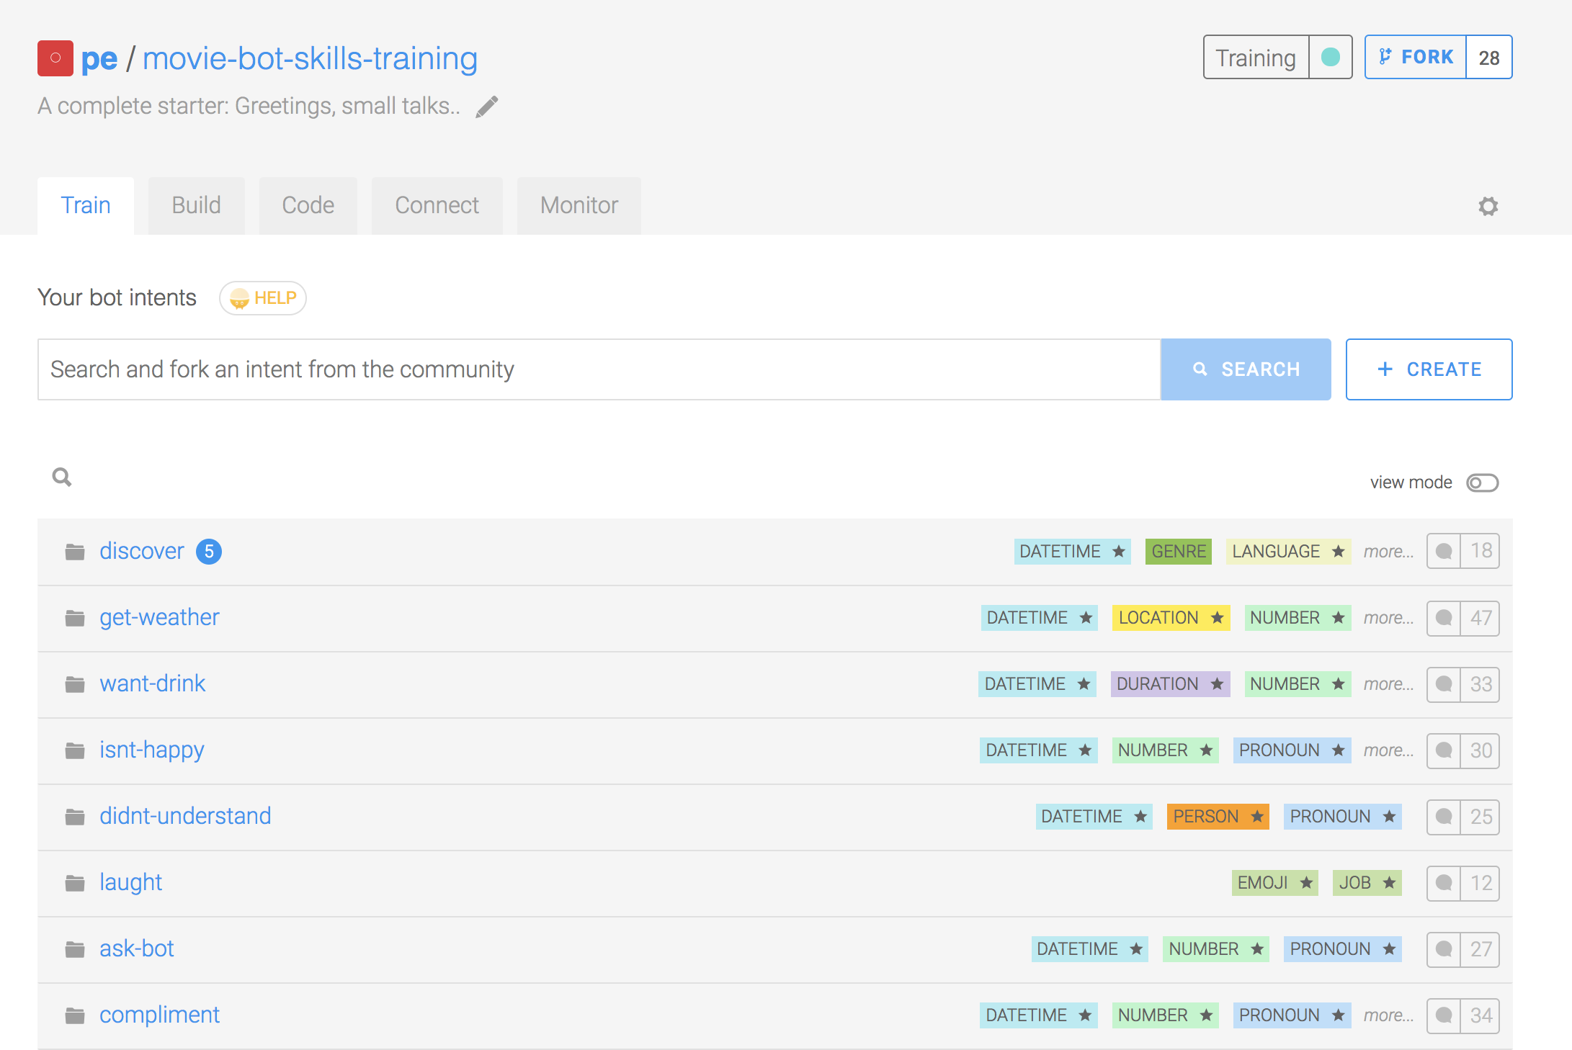
Key concepts #2 NLP – Intents, expressions & entities
An intent is a box of expressions that mean the same thing but are constructed in different ways. Each one of your intents represents an idea your bot is able to understand.
A bot is made of intents

Slide 10
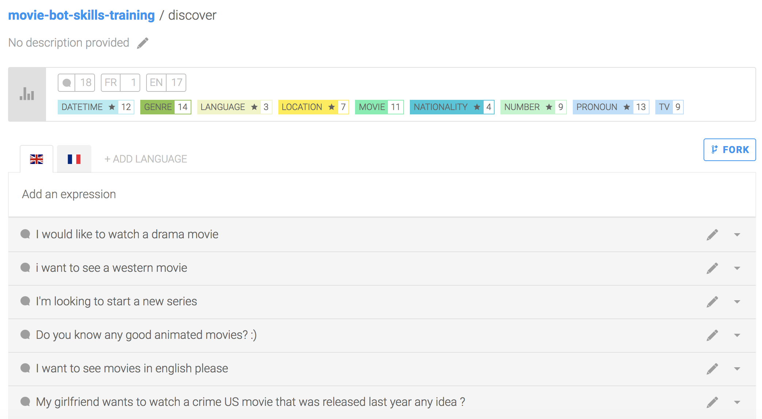
Key concepts #2 NLP – Intents, expressions & entities
An expression is a sentence your bot can understand: basically your users’ inputs. Expressions are organized in intents and constitute the entire knowledge of your bot.
Every intent is trained with expressions

Slide 11
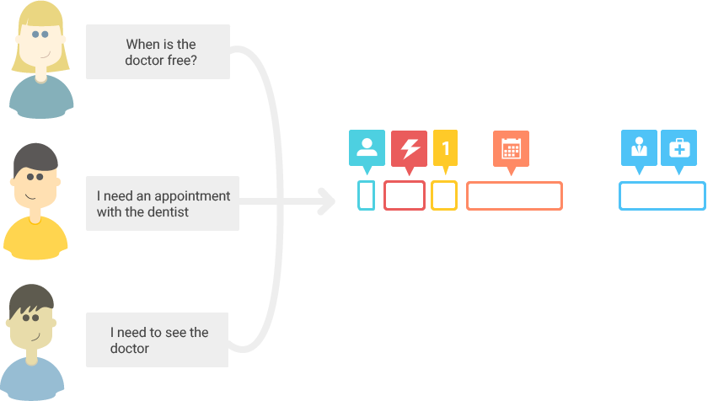
Key concepts #2 NLP – Intents, expressions & entities
I want to watch a movie
Any good western tonight?
I want to start a new show!
greetings
discover-movie
weather
INTENT
The more expressions you have, the more precisely your bot will be able to understand its users. The aim is to detect in which intent box an expression the bot has never seen is.

Slide 12
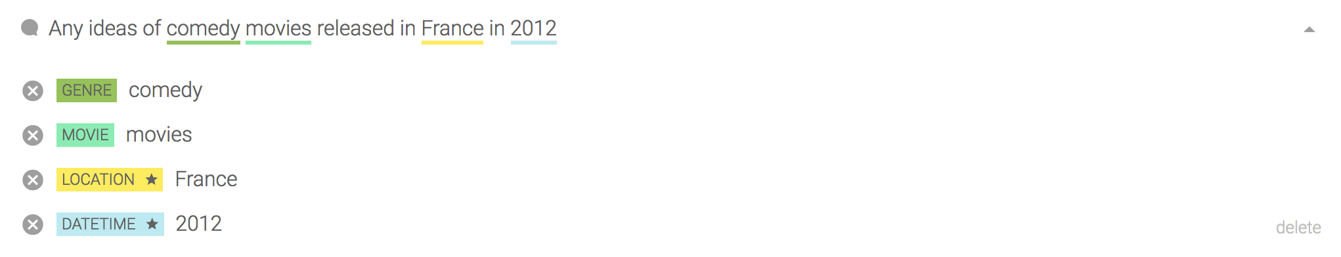
Key concepts #2 NLP – Intents, expressions & entities
An entity is a keyword extracted from an expression. We detect automatically 31 different entities such as datetimes, names, locations, etc.
Entities are extracted from each expression

Slide 13




Key concepts #2 NLP – Intents, expressions & entities
1
EXTRACTION
2
ENRICHMENT
"datetime": [ {
"formatted": "Sunday, 01 January 2012 at 12:00:00 AM (+0000)", "iso": "2012-01-01T00:00:00+00:00", "raw": "in 2012" } ]
3
NORMALISATION

Slide 14
Key concepts #2 NLP – Intents, expressions & entities
Entities with a black star next to them are called Gold entities they are automatically detected and extracted. But you are not limited to these Gold entities: you can also tag your own custom entities to detect keywords depending on your bot's context, such as movie genres if you are building a movie bot.

Slide 15
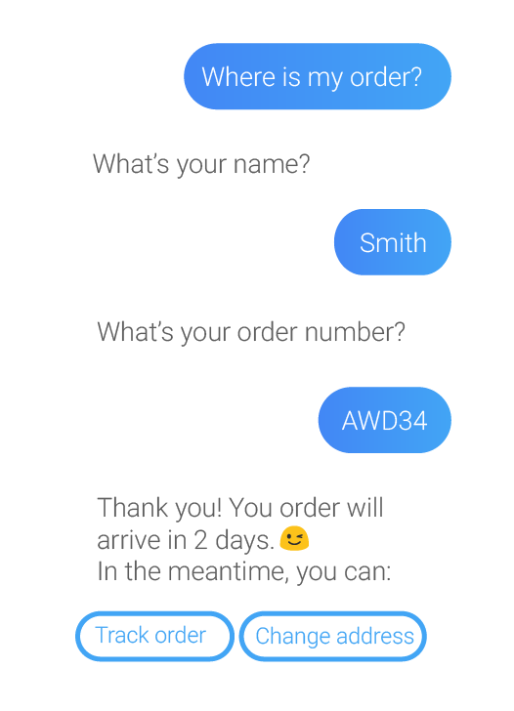
Key concepts #3 Conversation - Skills
A bot conversation is made of Skills.
A skill defines a specific block of conversation that has a clear purpose.
A skill can be as simple as the ability to greet someone, but it can also be more complex, for example giving movie suggestions based on information provided by the user.

Slide 16
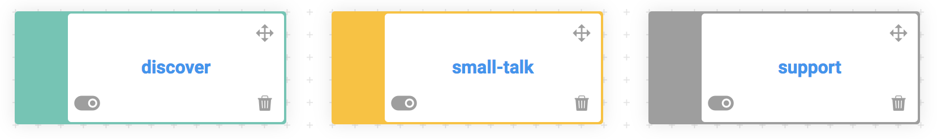
Key concepts #3 Conversation - Skills
Closely linked to the core purpose of your bot
Small talk and non-core related questions
Will be triggered automatically if no other skills is
Business
Floating
Fallback

Slide 17
Key concepts #3 Conversation - Skills
Triggers
Conditions determining if the skill should or shouldn't be activated
Requirements
Determining the information the bot needs to retrieve from the user, and how to retrieve it
Actions
Performed by the bot when all requirements are complete (for example, send a message)

Slide 18
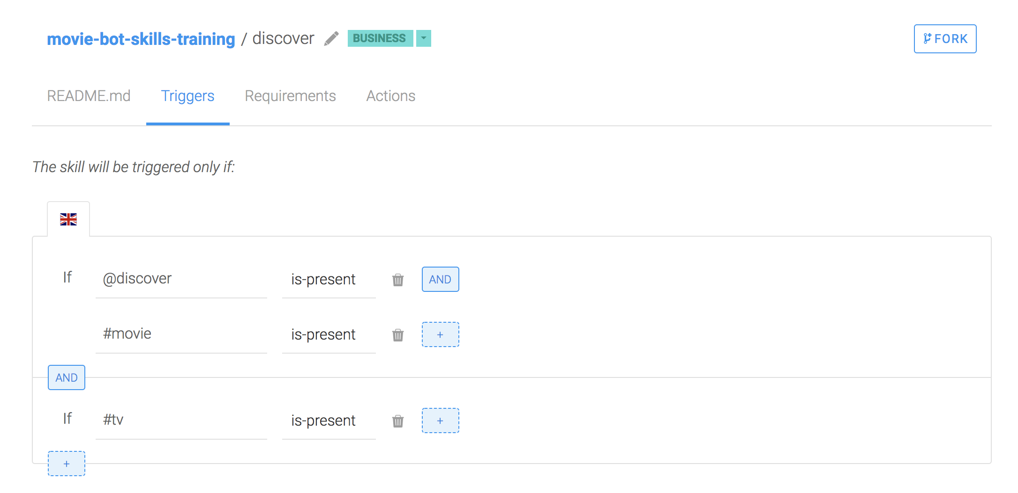
Key concepts #3 Conversation - Skills
Conditions define tests that will either be true or false. You will find conditions in different parts of your skill: triggers, requirements and in each message group in actions.
Skills have conditions

Slide 19
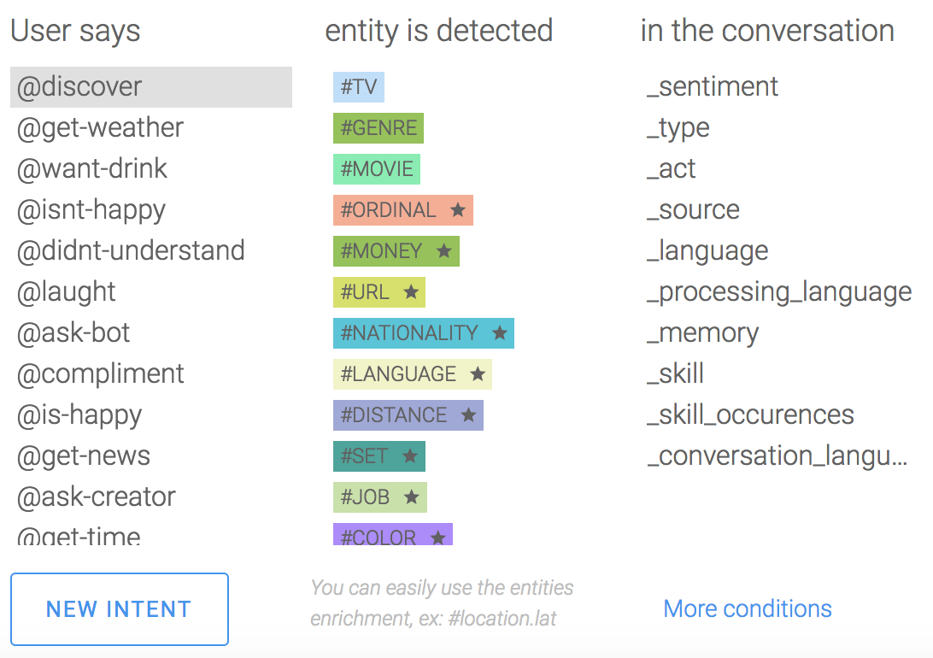
Key concepts #3 Conversation - Skills
Inside your data conditions, you will find a list of operands.
@ means intent
# means entity
_ means NLP attribute
Conditions have operands

Slide 20
Key concepts In summary…
Intents
Entities
Skills
To summarise a bot is made of intents that are made of expressions that contain entities. Intents and entities are used by Skills to manage conversation

Slide 21
Bot monitoring – Log feed
Log feed allows you to monitor and train your bot :
Assign new intent
Tag entity
It is possible to see or extract (csv) based on:​
A specific period​
Matching strictness
Language
One or many intents
​
Combining filters is possible

Slide 22
Bot monitoring – Usage analytics
Usage Metrics allows you to follow:
Number of users and conversations
Popular skills / intents / entities
Skills / intents / entities usage
-> based on a specific period if needed

Slide 23

Divider page

Slide 24
Insert page title (sentence case)

Slide 25
Insert page title (sentence case)

Slide 26
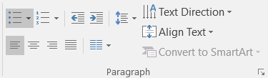
Insert page title (sentence case)
First level
Second level
Third level
NOTE: Delete the yellow stickers when finished.
The text placeholders have different, preformatted text levels. Each level has different formatting (font size, indent, bullet).
To jump between the preformatted text levels, use the Increase List Level and Decrease List Level buttons in the Paragraph toolbar.
Type your text in the placeholder.
Click the Increase List Level button in the Paragraph toolbar to go to the next level.
If you need a bullet list, choose level 2.
Avoid working with spaces, other bullets, or bullets in the wrong level. Only when you use the right levels it is possible to reset the slide layout.

Slide 27
Insert page title (sentence case)
First level
Second level
Third level

Slide 28
Insert page title (sentence case) Subheadline
First level
Second level
Third level

Slide 29
“Quote goes here and here and here.”
Source

Slide 30
“Quote goes here and here and here.”
Source

Slide 31
Insert page title (sentence case)
First level
Second level
Third level

Slide 32
Insert page title (sentence case)
First level
Second level
Third level

Slide 34
Insert page title (sentence case)
First level
Second level
Third level
First level
Second level
Third level

Slide 35
Insert page title (sentence case)
First level
Second level
Third level
First level
Second level
Third level
First level
Second level
Third level

Slide 36
Insert page title (sentence case)
First level
Second level
First level
Second level

Slide 37
Insert page title (sentence case)
First level
Second level
First level
Second level
First level
Second level

Slide 38
Thank you.
Contact information:
F name L name
Title
Address
Phone number
Partner logo

